Slide 1
Liver fuction test Jaundice

Slide 2
Structure of Liver
Liver:
Vital and largest organ in the body
Large consumer of O2 in the body
Its function, metabolism, synthetic function, detoxification and elimination of substances from the body.
Structure of the liver:
The liver is made up of hexagonal lobules of cells. Rows of hepatocytes radiate from the central hepatic vein and are separated by sinusoidal spaces, along the wall of which are interspersed hepatic macrophages (the kupffer cells)

Slide 3
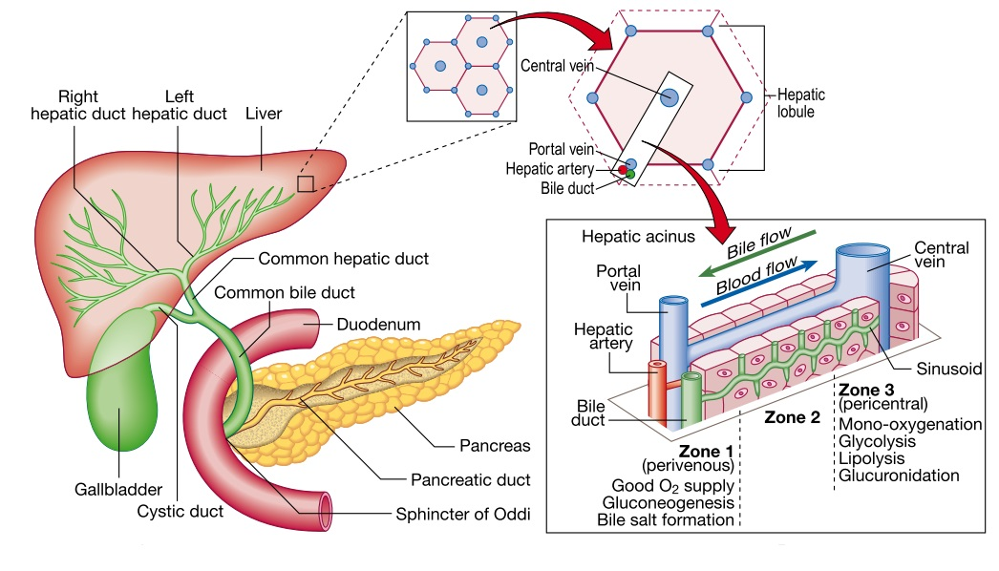

Slide 4
Functions of liver
1] Metabolic function:
• Carbohydrate metabolism
• Lipid metabolism
2] Synthetic function:
• Plasma protein ( Except immunoglobulin and complements)
• Coagulation factor ( 1972 )
• Primary bile acids
The liver has large functional reserve, deficiency in the synthetic function can only detected if liver disease is extensive
3] Excretory and detoxification function:
• Metabolism and excretion of bilirubin
• Many drug metabolized and inactivated

Slide 6
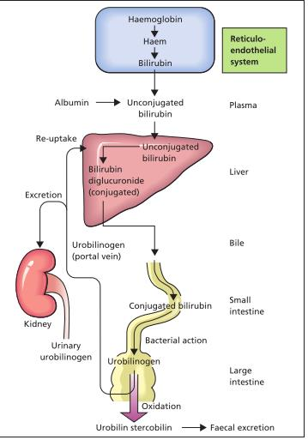
Bilirubin metabolism

Slide 7
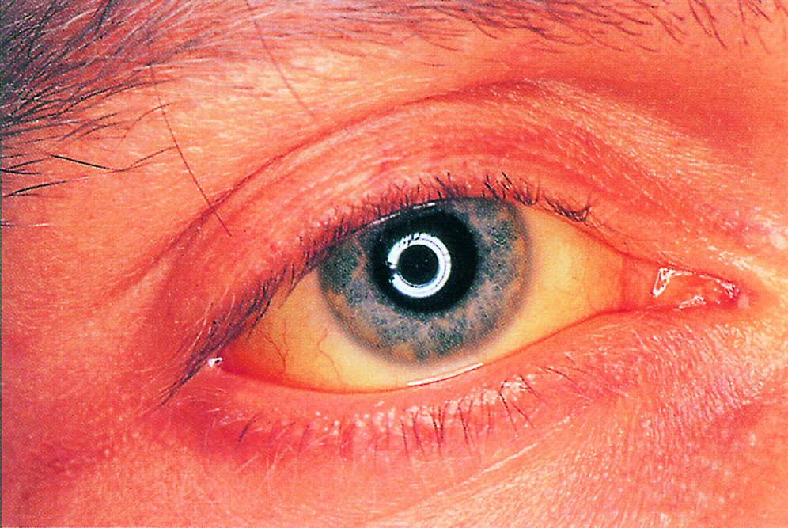
Jaundice:
Jaundice is a yellow discoloration of the skin or sclera. This is due to the presence of bilirubin in the plasma in a concentration is greater than about 50 µmol/L.[3 mg\dl]
Types of jaundice according to the site of disorders:
Prehepatic jaundice:
An increased rate of bilirubin production exceeds normal binding capacity of the liver to conjugation, like in Hemolytic anemia Due to drugs or toxins like arsenate.
Hepatic jaundice:
The load of bilirubin is normal, but cannot be conjugated and /or excreted by damaged liver cells like in Crigler-Najjar and Gilbert’s Syndrome
Post hepatic jaundice:
The biliary flow is obstructed, so that conjugated bilirubin cannot be excreted into the intestine and is regurgitated into the systemic circulation like in gallstone, carcinoma of the head of the pancreas, hydatic liver disease and primary biliary cirrhosis.

Slide 8
Types of hyperbilirubinemia: 1]Unconjugated hyperbilirubinemia 2]Conjugated hyperbilirubinemia
1] Unconjugated hyperbilirubinemia
Occur when there is increase in bilirubin load in:
1) hemolysis Hemolytic jaundice
2) Neonatal jaundice
Or impaired conjugation of bilirubin to glucoronate in the liver in:
Inherited unconjugated hyperbilirubinemia
1) Gilbert’s syndrome
2) Crigler-Najjar syndrome

Slide 9
Hemolytic jaundice
There are many causes of haemolysis, including sickle cell anaemia, thalassaemia and spherocytosis, and it can also be drug or autoimmune induced.
Unconjugated hyperbilirubinemia: the liver is healthy. There will be high amounts of AST and lactate dehydrogenase (LDH1 and LDH2). Blood reticulocytes may be raised, with abnormal blood film and a low plasma haptoglobin concentration.
Neonatal jaundice
Accelerated hemolysis around the time of birth, immature hepatic system for the uptake, conjugation and secretion of bilirubin.
Physiological jaundice: normal full term babies show jaundice between days 2-8 of life.

Slide 10
Jaundice during the first 24 hr of life is more likely to be pathological than physiological.
Kernicterus: toxic encephalopathy occur when the amount of unconjugated bilirubin exceed the protein binding capacity, the unbound bilirubin [lipid soluble] can penetrate the blood-brain barrier.
Inherited unconjugated hyperbilirubinemia: include
1] Gilbert syndrome (present in the second decade)
Caused by decreased expression of bilirubin UDP-glucuronyltransferase, due to a mutation in the promoter portion of the gene.
It is more common 2-7 times in men than women.
2] Crigler-Najjar syndrome
This is due to absence or decrease activity of enzyme
It is a more serious condition. It usually presents at birth.
The plasma unconjugated bilirubin may increase to concentrations that exceed the binding capacity of albumin and so cause kernicterus.

Slide 11
2] Conjugated hyperbilirubinemia
results from
blockage of the hepatic or common bile ducts
bilirubin diglucuronide cannot be excreted
Inherited conjugated hyperbilirubinemia
Dobin-Jonson Syndrome
It is a rare inherited disease during childhood or adult life
Benign disorder that causes defect in excretion of bilirubin into the serum,
Characterized by hepatomegaly and causes a black liver due to the deposition of a pigment similar to melanin.
If there is no pigment , it is called (Rotor syndrome)

Slide 12
Notes:
Total serum bilirubin level is the sum of the conjugated and unconjugated bilirubin.
Although the terms jaundice and icterus are used interchangeably, the term icterus is most commonly used in the clinical laboratory to refer to a serum or plasma sample with a yellow discoloration due to an elevated bilirubin level.
Unconjugated bilirubin is normally all protein bound and is not water soluble and therefore cannot be excreted in the urine. Patients with unconjugated hyperbilirubinaemia do not have bilirubinuria (‘acholuric jaundice’) such as Gilbert’s syndrome.
Conjugated hyperbilurubinemia [choleric jaundice].
Conjugated bilirubin is water soluble and is less strongly protein bound than the unconjugated form, and therefore can be excreted in the urine.
Bilirubinuria is always pathological. Dark urine may be an early sign of some forms of hepatobiliary disease.

Slide 13
Diseases of the liver: Hepatocellular damage:
Enzymes: Liver enzymes play an important role in the assessment of liver function because injury to the liver resulting cytolysis and will cause the release of enzymes into circulation.
** It is important to note that the diagnosis of disease depends on a combination of
patient history
physical examination
laboratory testing.
sometimes radiologic studies and biopsy.

Slide 14
Aminotransferase measurments:
The two most common aminotransferases measured in clinical laboratory are AST and ALT
ALT is found mainly in the liver (lesser amounts in skeletal muscle and kidney), whereas AST is widely distributed in equal amounts in (the heart, skeletal muscle, and liver), making ALT a more “liver -specific” marker than AST.
Hepatitis: means inflammation of the hepatocytes

Slide 15
Notes:
A rise in plasma aminotransferase activities is a sensitive indicator of damage to cytoplasmic and/ or mitochondrial membranes. Plasma enzyme activities rise when the membranes of only very few cells are damaged
The highest level of AST and ALT are found in acute conditions such as viral hepatitis, drug-and toxin-induced liver necrosis[acetaminophen], and hepatic ischemia. The increase in ALT activity is usually greater than that for AST.
AST and ALT are found to be normal or only mildly elevated in cases of obstructive liver damage.

Slide 16
Hepatic excretory function: Cholestasis:
Intrahepatic cholestasis: in which bile secretion from the hepatocytes into the canaliculi is impaired, due to:
viral hepatitis
drugs such as chlorpromazine or toxins such as alcohol
inflammation of the biliary tract (cholangitis)
autoimmune disease (primary biliary cirrhosis)
Extrahepatic cholestasis: due to obstruction to the flow of bile through the biliary tract by:
biliary stones
Inflammation of the biliary tract
Pressure on the tract from outside by malignant tissue like carcinoma of the head of the pancreas.

Slide 17
Alkaline phosphatase [ALP]
Alkaline phosphatase:
Alkaline phosphatase is derived from a number of different tissues, including the liver, the osteoblasts in bone, bile duct and the placenta. Plasma activities in cholestatic liver disease because ALP synthesis is and the enzyme within the biliary tract regurgitated into plasma.
A raised ALP concentration in the presence of a raised ¥-glutamyl transferase (GGT) concentration implies that the ALP is of hepatic origin.

Slide 18
Gamma -Glutamyl transferase:
¥-Glutamyl transferase: is a membrane-localized enzyme found in high concentrations in the kidney, liver, bile duct, pancreas, intestine, and prostate, it is an enzyme derived from the endoplasmic reticulum of the cells of the hepatobiliary tract . As this reticulum proliferates, for example: In response to the prolonged intake of alcohol and of drugs like phenobarbital and phenytoin ,, Synthesis of the enzyme is induced ,, plasma GGT activity increases,,
therefore, raised plasma activities do not necessarily indicate hepatocellular damage, but may reflect enzyme induction or cholestasis.

Slide 19
Examples of increased level of ALP:
Liver
Intrahepatic or extrahepatic cholestasis.
Primary or metastatic liver tumor.
Others
Bone disease
Physiological, during the last trimester of pregnancy.
In children, the total activity increases by about two to five times during the pubertal bone growth.

Slide 20
Primary biliary cirrhosis:
This is a rare autoimmune disorder that occurs most commonly in middle-aged women. Destruction and proliferation of the bile ducts produce :
a predominantly cholestatic picture
pruritis
plasma ALP activity that may be very high
Jaundice develops late in most patients
Mitochondrial antibodies (IgM) are raised in the plasma
Patients may also manifest hypercholesterolaemia, xanthelasma and osteoporosis.

Slide 21
Hepatic synthetic function:
Albumin: In chronic hepatocellular damage, there is impaired albumin synthesis with an accompanying fall in serum [albumin]. In acute liver disease, however, there may be little or no reduction in serum [albumin],as the biological half-life of albumin is about 20 days.
Note: There are many other causes of a low plasma albumin concentration that are not due to hepatic disease.
Prothrompin time: The prothrombin time may be prolonged by cholestasis, fat-soluble vitamin K cannot be absorbed normally if fat absorption is impaired due to intestinal bile salt deficiency. The abnormality is then corrected by parenteral administration of the vitamin.

Slide 22
Specimen:
Serum is used for analysis.
Fasting is preferred.
Avoid hemolysis during sample collection.
Interfering factors:
1- Drugs that may increase levels of total bilirubin include:
Allopurinol
Morphine
Diuretics
oral contraceptives
Rifampicin
2- Drugs that may decrease levels of total bilirubin:
Barbiturates
Caffeine
Penicillin
3- Avoid the exposure of the specimen to sunlight or high intensity artificial light at room temperature because this will decrease bilirubin content.
4- Certain food (e.g. Carrots), may increase yellow pigment in serum, it may lead to false results

Slide 23
